Slide 1
BP26 Draft 2 Q&A - Welcome
3 December 2025

Slide 2

Objectives
To outline the key changes between BP26 Draft 1 and BP26 Draft 2
To provide an update on:
  Investment Proposals
  Budget
To give customers the opportunity to ask questions and provide their feedback
A summary of next steps
3 December 2025

Slide 3
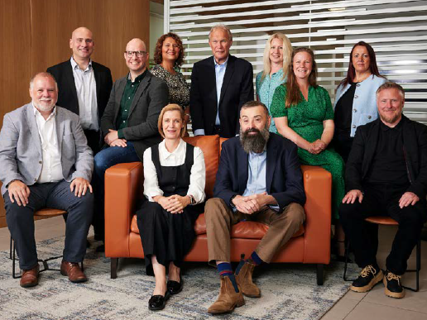
Agenda
Welcome – Jade Lester
BP26 so far – Steve Brittan
Key Changes Summary – Lee Eltherington
BPIR Compliance – Mark Jobson (Kearney)
CDSP Service Enhancement IP – James Rigby
DSC Contract Budget IP – James Rigby
Information Security – Lee Eltherington
Budget – James Spicer
Q&A – All
Close and Next Steps – Steve Brittan
3 December 2025

Slide 4
01
BP26 journey
so far
3 December 2025

Slide 5
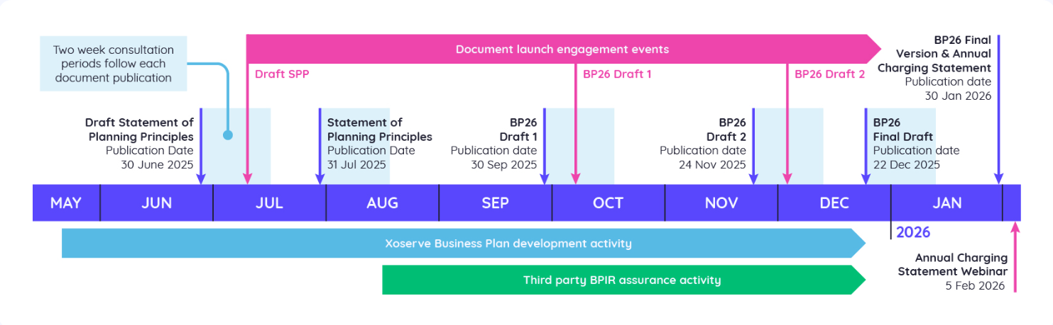
Customer Engagement
We have carried out a range of activities during the BP26 cycle so far, aimed at informing, promoting and taking your views about our Business Plan development:
25 bilateral meetings
BP26 Drafts and all associated documents published online, receiving over 900 views
Hosted Customer Strategy Day (attended by 34 customers and stakeholders) and Pain Point Roadmap event
3 webinars (70 attendees in total)
BP26 LinkedIn posts x 9, reaching 12,000 followers, earning 1,600 clicks and 400 engagements
Presented regular updates in CoMC and constituency meetings
3 December 2025

Slide 6
02
Key
Changes
3 December 2025

Slide 7
Key Changes Summary
BP26 Draft 2 Changes - No impact on BP26 Budget
Customer feedback on BP26 Draft 1 | How have Xoserve acted on feedback
Include more information on Project Trident, specifically around risks, budget, procurement and timelines. | Additional information on activities and timelines has been included of the Main BP26 Draft 2 document, and a closed confidential Customer briefing was held on 26 November.
Include non-operational metrics in the Business Plan. | Through the MtM project and in conjunction with our Customers, a new draft Strategic Scorecard containing 12 metrics has been included in Draft 2.
Customers wanted to see improvements made against BPIR Assurance through the BP Cycle. | Kearney have scored Xoserve 71% on the standard metric and 93% on the adjusted compliance score.
3 December 2025

Slide 8
Key Changes Summary
BP26 Draft 2 Changes – Increased Investment Budget in BP26
Customer feedback on BP26 Draft 1 | How have Xoserve acted on feedback
General Change budget should not be utilised for Non-technical change with these types of changes being approved in the DSC Contract Management Committee. | A new Investment Proposal, called DSC Contract Budget, has been raised which proposes ring-fenced funds for non-technical change. Following customer feedback we are seeking agreement from ChMC to remove this from the General Change budget
Additional security provision budget should be included in the UK Link estate. | Additional budget has been proposed in the UK Link Sustain Investment Proposal.
To include more detail on Pain Points in the CDSP Service Enhancement Investment Proposal. | A Pain Point Feasibility Analysis Summary has been included in the Investment Proposal. Draft 2 proposes an additional budget for 27/28 & 28/29 in the General Change Budget. This will move to the Service Enhancement budget in the Final Draft following Customer feedback
3 December 2025

Slide 9
Key Changes Summary
BP26 Draft 2 Changes – Increased S&O Budget in BP26
Customer feedback on BP26 Draft 1 | How have Xoserve acted on feedback
The Audit & Risk Committee recommended Xoserve enhance its Business Continuity Management (BCM). | A new budget line has been included in S&O.
Provide more information on the Data Discovery Platform 2 upgrade and the findings / impacts from the PAC Audit. | We have included additional information on the Data Discovery Platform 2 upgrade in Draft 2. We are re-starting the programme and will be able to provide an update on the roll out plan in the new year. The publication of the PAC audit has been delayed so findings / impacts are not available.
3 December 2025

Slide 10
03
BPIR Compliance
3 December 2025

Slide 11
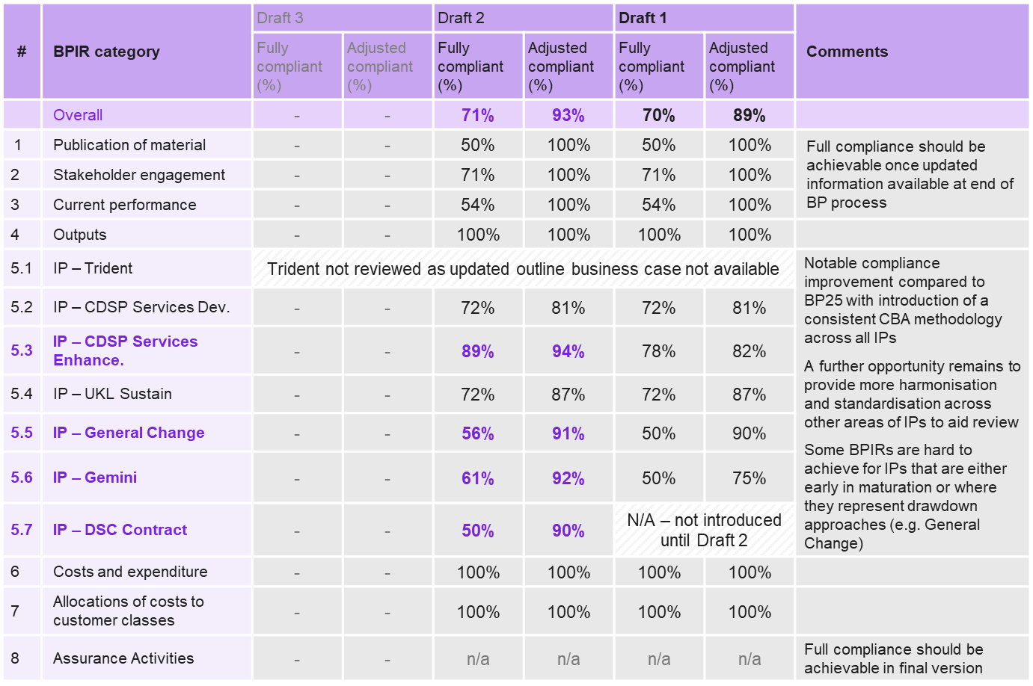
BPIR Compliance
Xoserve scored 71% on the standard metric and 93% on the adjusted compliance score for its second draft of BP26.
This improved score can be attributed to enhancements made to 3 Investment Proposals, based on customer feedback and recommendations provided in BP26 Draft 1
Trident has not been scored at Draft 2 against the BPIR, as the finalisation of the Outline Business Case (OBC) is running to a different timeline to BP26
  An assurance of the OBC is anticipated when it is ready for review
3 December 2025

Slide 12
04
CDSP Service Enhancement IP
3 December 2025

Slide 13








Pathway to addressing Pain Points
Customer feedback
To include more detail on Pain Points in the CDSP Service Enhancement Investment Proposal.
We have explored and evaluated feasible options to address customer pain points relating to UK Link and its surrounding architecture, to determine which can be reasonably addressed, and to establish the appropriate timing and approach to do so.
PAIN POINT WORKSHOPS
We ran a series of pain point workshops with Customers, to validate pre-identified pain points, reveal unidentified pain points, and provide considerations for the options of these.
PLAY BACK AND RECOMMENDATIONS
We played back the process to Customers before building out tangible next steps to address pain points either within Project Trident or another part of Xoserve, alongside ongoing customer engagement.
FEASIBILITY
ANALYSIS
EXPLORE OPTIONS
BUNDLE
INTO ‘REFORM PACKAGES’
PAIN POINT WORKSHOPS
FEASIBILITY
ANALYSIS AND BUNDLING
PLAY BACK
AND RECOMMEND-ATIONS
VALIDATED PAIN POINTS
PROVIDED CONSIDERATIONS
PLAY
BACK TO INDUSTRY
IMPLEMENTATION ROADMAP
IDENTIFIED NEW PAIN POINTS
RECOMMENDATIONS AND DRAFT 2 BP26
INPUT
FEASIBILITY ANALYSIS AND BUNDLING
We completed a series of feasibility analyses against these pain points; identifying options and associated costs and benefits via Xoserve workshops. We then bundled them into ‘enhancement packages’ to inform how and when they should be implemented.

Slide 14
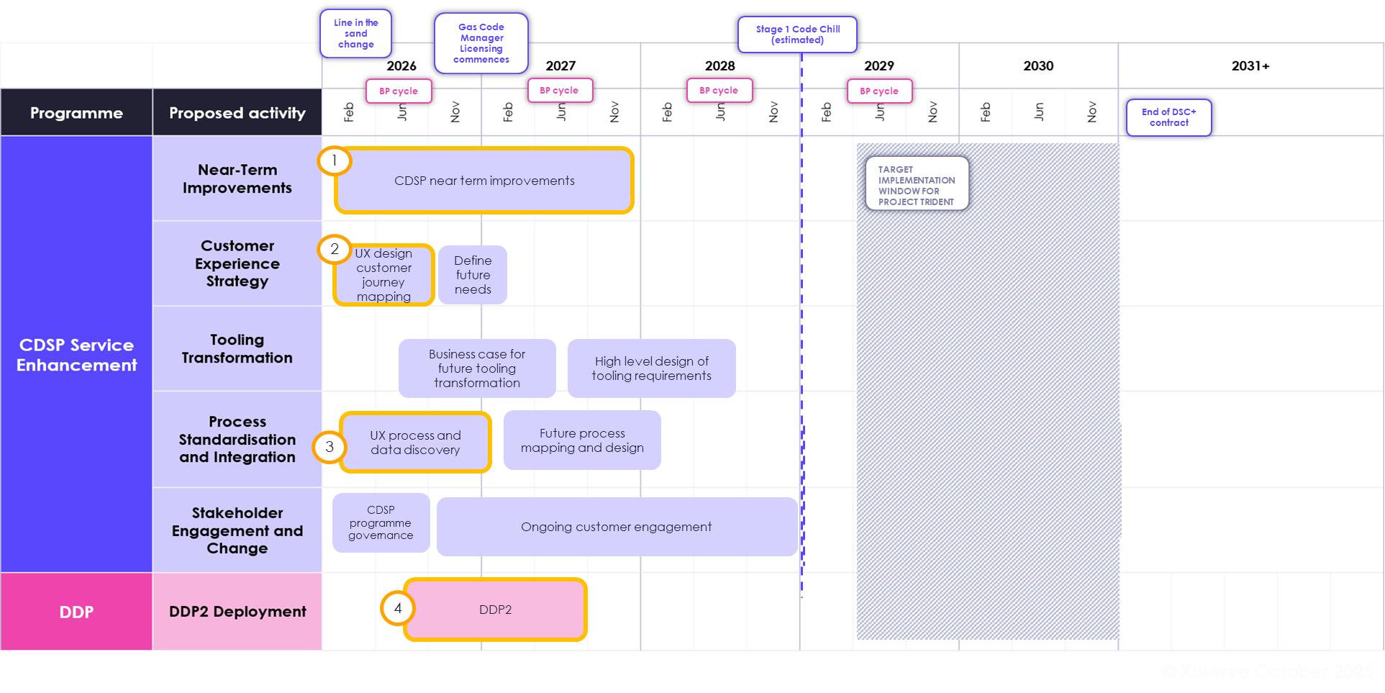
Pain Point Roadmap
3 December 2025

Slide 15
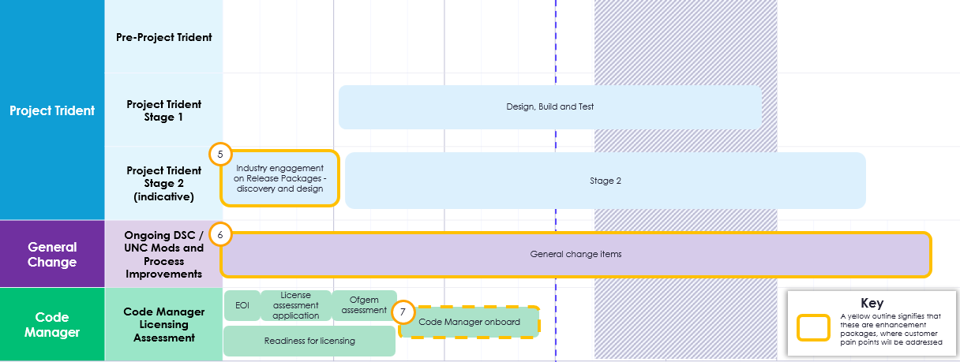
Pain Point Roadmap
3 December 2025

Slide 16
05
DSC Contract Budget IP

Slide 17
DSC Contract Budget
Customer feedback
General Change budget should not be utilised for Non-technical change with these types of changes being approved in the CoMC.
Discussions have been held in DSC Contract Management Committee (CoMC) on governance and budget for non-technical activities that arise during the financial year.
Xoserve presented 4 options to Customers in CoMC on the 19 November.
Option 1 - Preferred
Option 2
Option 3
Option 4
Introduce a new Investment line that is managed by CoMC in relation to contract related change (DSC Contract Budget)
Retain 1 budget (DSC Change Budget) with ChMC becoming the recommending body for the change being proposed and CoMC the approving body for funding the change
Apply a margin to General Change Budget that can be used to fund unforeseen activities and approved by CoMC – examples of which could include PAC Audit, BPIR Assurance, Legal Opinion
Do nothing
3 December 2025

Slide 18
06
Information Security
3 December 2025

Slide 19
Information Security
Customer feedback
Additional security provision budget should be included in the UK Link estate.
Xoserve recognises the importance of Information Security and the need to protect Customers’ data from the threat of cyber attacks
At the October Board Meeting, the board directed Xoserve to include additional budget for Information Security in the UK Link estate
Nick Boughey, Xoserve’s Information Security & Privacy Manager, has offered to hold a closed confidential session, or join customer bilateral meetings to share our Information Security strategy
Due to sensitivity of the information, this briefing will be only available to Chief Information Security Officers
Please contact Liam Glorney (liam.glorney@xoserve.com) or James Verdon (james.verdon1@xoserve.com) from the Customer Engagement Team if this is of interest
3 December 2025

Slide 20
07
Budget Update
3 December 2025

Slide 21
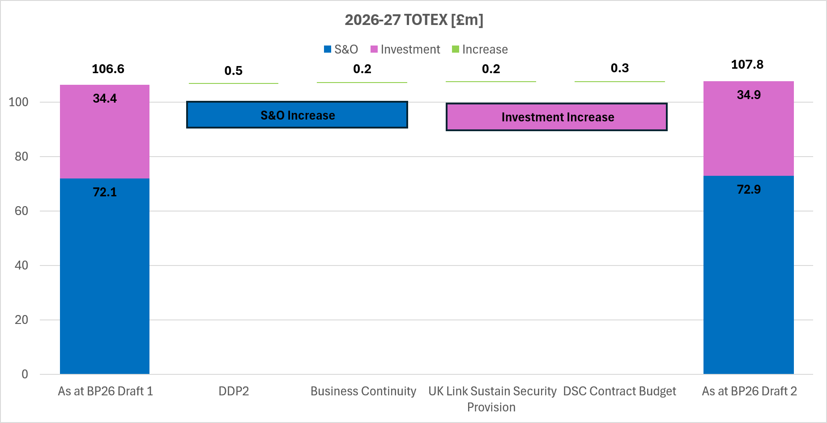
Budget
£1.2m increase to 2026-27 TOTEX
3 December 2025

Slide 22
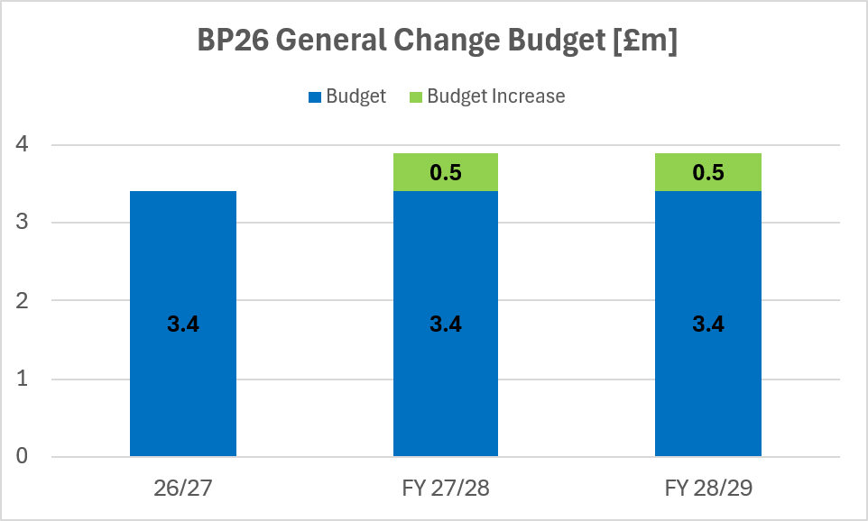
Budget
£0.5m added to 2027-28 and 2028-29 forecast
3 December 2025

Slide 23

Questions?

Slide 24
08
Final Thoughts
& Next Steps

Slide 25
Thank You

