Slide 1
BP26 Draft 1 Q&A - Welcome
21 October 2025

Slide 2
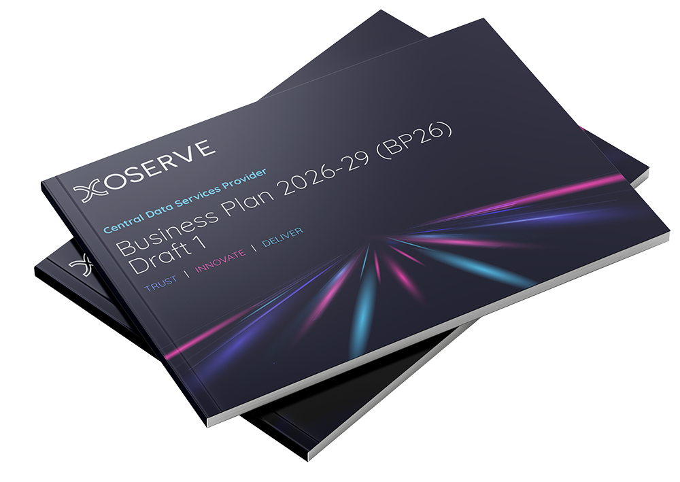
Objectives
To provide a summary of the consultation findings and customer feedback received to date
To play back our understanding of the customer feedback
To give customers opportunity to provide any additional thoughts prior to the preparation of BP26 Draft 2 (to be published on 24 November)
21 October 2025

Slide 3
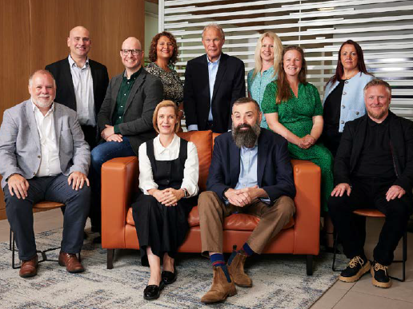
Agenda
Welcome – Jade Lester
Customer Feedback – James Rigby
Trust – James Spicer
Innovate – Clive Nicholas
Deliver – Dave Turpin
Independent Assurance – Mark Jobson
Final Q&A – All
Close and Next Steps – Steve Brittan
21 October 2025

Slide 4

01
Customer Feedback
21 October 2025

Slide 5
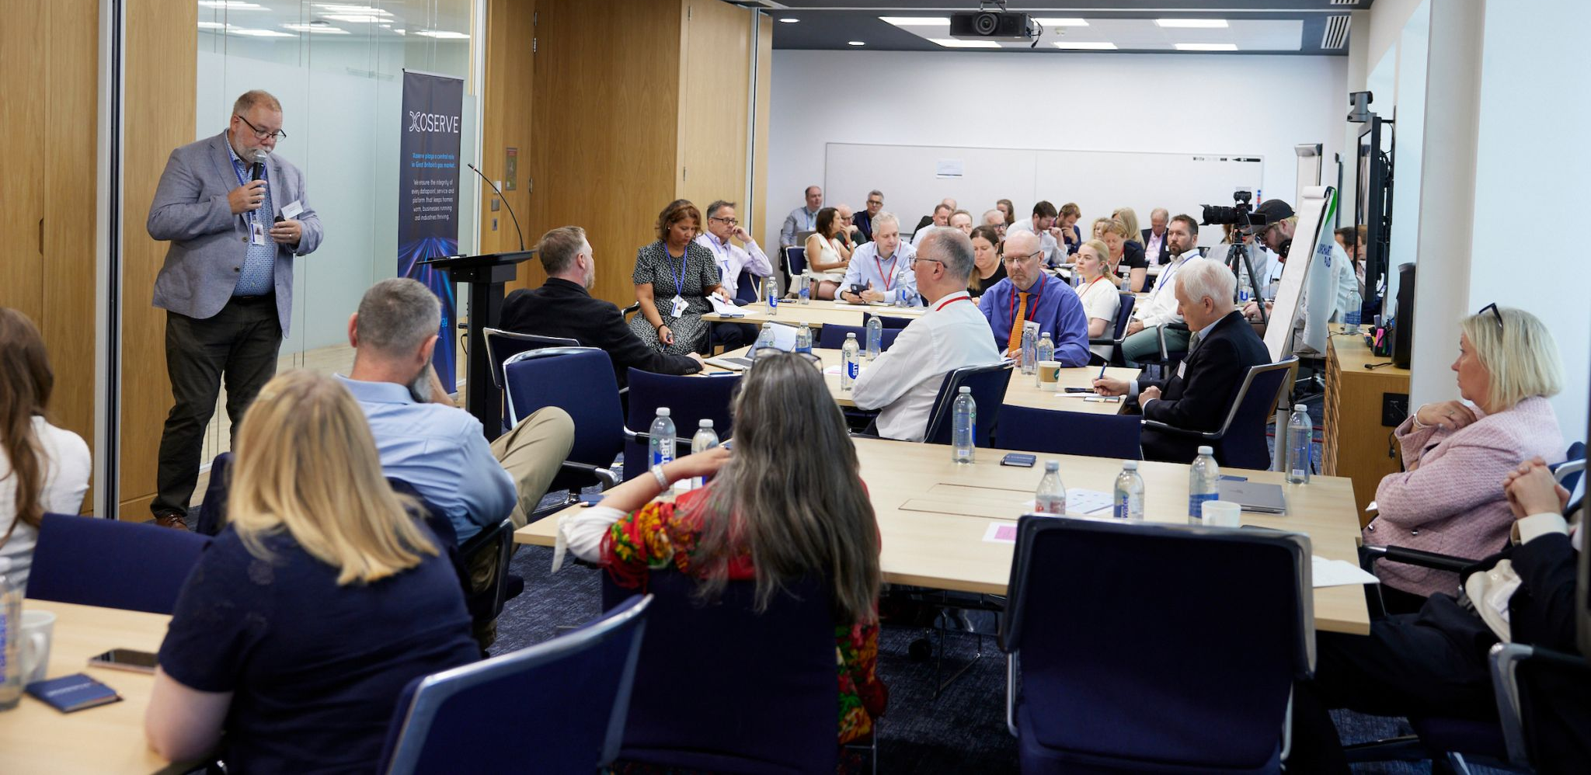
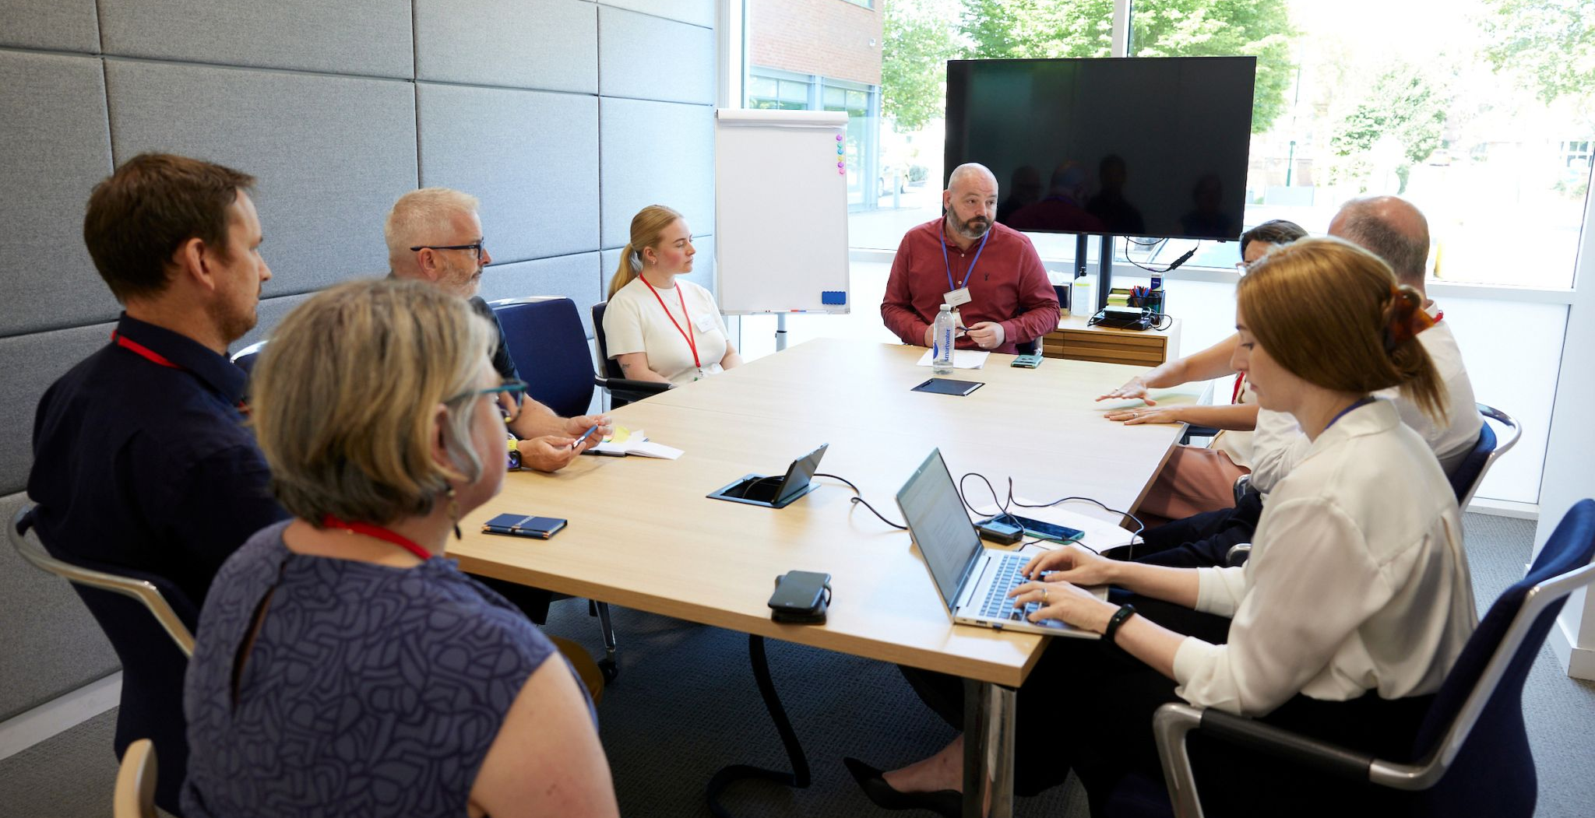
Customer Engagement
We have carried out a range of activities during the BP26 cycle so far, aimed at informing, promoting and taking your views about our Business Plan development:
15 bilateral meetings
BP26 Draft 1 and all associated documents published online, receiving over 550 views
Hosted Customer Strategy Day (attended by 34 customers and stakeholders)
Presented regular updates in CoMC
2 webinars
BP26 LinkedIn posts x 7, reaching 10,000 followers, earning 1,500 clicks and 300 engagements
21 October 2025

Slide 6
Customer Feedback
“The Customer Strategy Day was a valuable insight into Xoserve’s future plans. The event was exceptionally well organised and provided a meaningful opportunity for customers to engage directly with your senior leadership team”
“We appreciate the increased level of stakeholder engagement this year, and the provision of multiple avenues for customer feedback is a welcome and progressive step”
“We have seen more collaborative and positive customer engagement”
“We recognise the positive steps that Xoserve has taken in Draft 1 building on the feedback and information provided in the final SPP”
“We would like to acknowledge that Business Plan 2026 demonstrates overall improvement from Business Plan 2025 and the content is well-focused without extraneous detail”
21 October 2025

Slide 7
02
Trust Feedback
21 October 2025

Slide 8
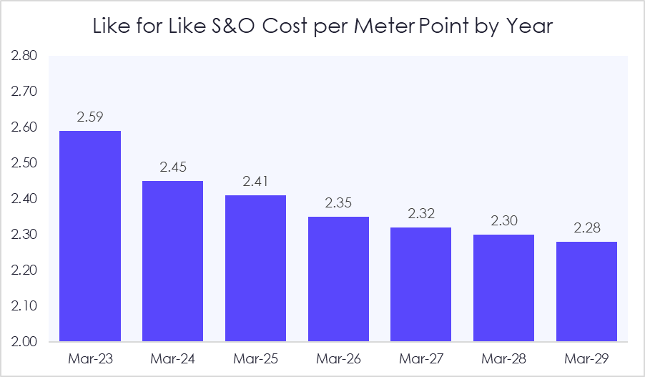
Draft 1 Highlights – Trust
Our cost per meter point continues to reduce on a like for like basis
Our adjusted BPIR compliance score of 89% is a 7% improvement on last year at D1 stage
In our ERIX Programme 41 of 46 findings (89%) have been closed, demonstrating a strong commitment to implement the Efficiency Review findings to improve our performance and efficiency
21 October 2025

Slide 9
Value for Money Review
Trust
Question 1: We would like to understand your opinion as to whether we should:
Use the BP25 General Change budget to fund an updated version of the 2023 Review that would include all scope added to S&O since 2023 (BP23, BP24, BP25)
Incorporate an additional budget item in BP26 Draft 2 to fund a review ahead of BP27
Retrospectively apply the Cost/Benefit Analysis methodology to S&O cost increases for scope items that came into effect during BP23, BP24 and BP25
Customers felt that incorporating an additional budget item in BP26 Draft 2 to fund a review ahead of BP27 reflects customer engagement received to date and would create an independent budget item that can be scrutinised and evaluated by customers during the business plan cycle
One Customer felt it was prudent to undertake a review, like the previous efficiency review, given the beginning of the multi-year nature of Project Trident to ensure VfM analysis is undertaken
Any review undertaken must be cost effective and able to determine whether the services are efficient or not, with this being clear to customers
21 October 2025

Slide 10
Trust
Trust
Question 2: Is there anything that can be added, changed, removed or elaborated upon in Draft 1 of BP26 to increase your trust in Xoserve?
Cost / Benefit
Governance
Delivery
One customer felt the constituency costs did not always show how these align to benefits realised
One customer suggested the BP includes a clear governance structure and detail as to how this governance operate & makes decisions on investment proposal
One customer suggested having a dedicated section on what we asked to be delivered, and how Xoserve have either actioned this, or considered it
Transparency
BP Terminology
BP Documentation
One customer wanted to see Xoserve always strive for greater transparency at every given opportunity
One customer requested that consistent terminology be maintained throughout the next RIIO period
One customer appreciated a low ink BP but highlighted this was not included in draft 1’s resources
21 October 2025

Slide 11

Trust - Q&A
Trust
Have we interpreted your feedback correctly?
Do you have any further thoughts on what you have heard?
21 October 2025

Slide 12
03
Innovate
Feedback
21 October 2025

Slide 13
Draft 1 Highlights – Innovate
H100 (Hydrogen Trial)
Real Time Settlement Methodology
Providing data and system support to the UK’s first 100% hydrogen trial, enabling insights on billing, settlement, and system operability in a hydrogen environment
Supporting the team by data sharing and providing insights on settlement to support fair billing and accurate energy reconciliation in a multi-gas future
Girvan (Biomethane Integration)
Data Initiatives
Supporting the UK’s first non-propanated biomethane site, ensuring settlement and data exchange processes are ready for replication across the network
Embedding gas data in NESO’s RESP activity
Evolve relationship with REA for optimising the biomethane process
Managing Different Gases (System Readiness)
Project Trident market engagement
Jointly delivered with Gas Networks, quantifying CDSP impacts under scenarios for biomethane, 5%-20% hydrogen blends, and 100% hydrogen networks
Being transparent to customers and the market throughout our pre-procurement stage enabled discovery of tools and other vendors to support Project Trident
21 October 2025

Slide 14
Artificial Intelligence
Innovate
Question 1: Thinking about the trade-off between innovation and risk, how would you like to see Xoserve use Artificial Intelligence to develop new/enhance existing CDSP services?
Customers agreed that any introduction of AI must be safe, transparent, explainable whilst prioritising data security, regulatory compliance and robust testing.
Xoserve’s focus should be on using AI to make internal efficiencies whilst ensuring any deployment of AI does not impact the critical timeline and objectives of Project Trident.
21 October 2025

Slide 15
Trends, Policies, Industry Developments
Innovate
Question 2: In your opinion, what are the most important trends, policies and industry developments that we should consider during the BP26 development cycle?
Xoserve Focus
Data Best Practice
Ofgem’s SDS
The key focus for Xoserve must be regulatory certainty and core delivery
Xoserve should continue to make data available, accessible, and user friendly, recognising that Xoserve is looking at delivering a ‘Data Best Practice’ readiness activity
One customer would like more information on how Xoserve will look to act on Ofgem's Strategic Direction Statement (SDS)
Code Reform
Code Manager
Alternative Gases
Code Reform should continue to be a key consideration
One customer believes that although the industry's transition to Code Manager is important, the primary focus should be on the successful delivery of Project Trident, until Ofgem have made a formal decision.
One customer said Xoserve should consider any impacts to CDSP systems if a Hydrogen code is developed whilst also looking at what the developments in biomethane, hydrogen, and alternative gases could mean for the industry.
21 October 2025

Slide 16
Additional key themes
Innovate
Project Trident
DSC+ Contract Expiry
One customer has asked for detailed explanations of clear steps and updates taken, and wanted to understand more about the timings of procurement and the preferred option
One customer raised concerns with the potential risks associated with transitioning away from the current contract holder adding that any disruption to critical systems / processes, could risk Transporters and Shippers breaching their Licence Conditions.
CDSP Service Development Investment Proposal
One customer felt there were inconsistencies in 3 areas:
Significant Monetised Benefits: Some AI benefits are mentioned without context
Significant Monetised Risks: Make clear that licence non-compliance relates to GT’s not Xoserve
Implementation of Data Best Practice: Refers to all data being assessed, however as Shippers own most of the data and are not subject to Data Best Practice obligations placed on GT’s, there may be limitations
21 October 2025

Slide 17

Innovate - Q&A
Innovate
Have we interpreted your feedback correctly?
Do you have any further thoughts on what you have heard?
21 October 2025

Slide 18
04
Deliver Feedback
21 October 2025

Slide 19
Draft 1 Highlights – Deliver
Enhanced Assurance
Dedicated departments
Test Assurance
Measures That Matter
Customer Engagement Team
Service Managers
CDSP Service Enhancement Programme
Information Exchange Roadmap
Delivering solutions to UK Link pain points not in scope of Project Trident
Migration to the cloud network (CIX)
Ongoing support for industry participants
UK Link Sustain
General Change Investment
Maintaining vendor support across the estate, reducing technical and operational risk and allowing for a smooth and efficient transition to the future platform.
Supporting DSC code and non-code services
Data Discovery Platform (DDP) visualisation and data provision services
Retail Energy Code change development responsibilities
21 October 2025

Slide 20
CDSP Service Enhancement
Deliver
Question: In your opinion, what would be the best approach to the governance of this programme?
Use existing DSC committees, asking the relevant group the relevant questions
Choose either Change Management Committee (ChMC) or Contract Management Committee (CoMC) as ‘decision-maker
Have a combined ‘sub-group’ of CoMC and ChMC representatives to bring the required Customer expertise together to make decisions
Something else (please specify)
One customer suggested creating a combined ‘sub-group’ of CoMC / ChMC reps, offering the balance of operational and contractual considerations when overseeing, and approving work packages.
One customer suggested a hybrid, using either CoMC or ChMC for decisions on the CDSP Enhancement Programme that fall clearly within remit, whilst establishing a separate, dedicated Stakeholder Group for decisions specific to Project Trident
One customer emphasised it is crucial Xoserve maintains a strong emphasis on the core CDSP services to ensure continued reliability and performance.
21 October 2025

Slide 21
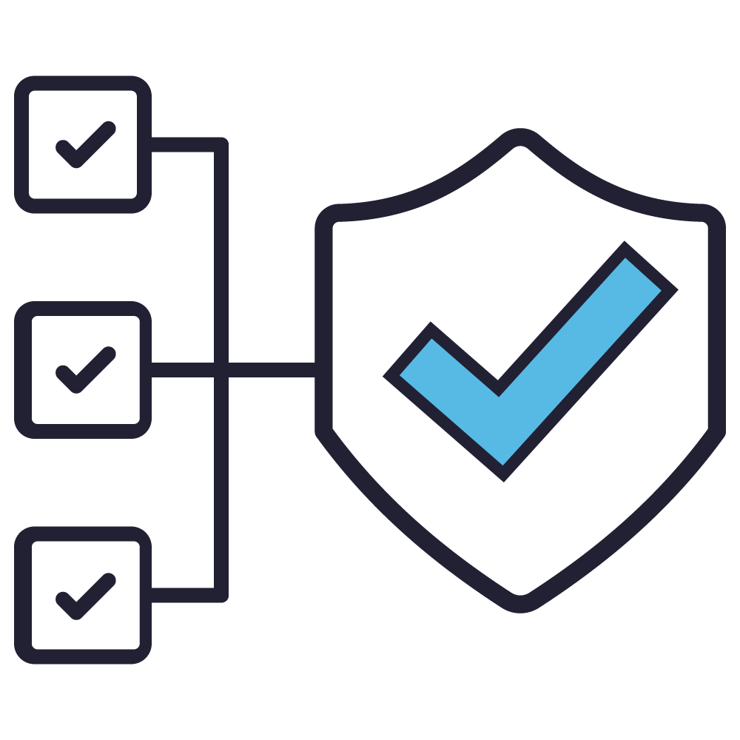
Deliver - Q&A
Deliver
Have we interpreted your feedback correctly?
Do you have any further thoughts on what you have heard?
21 October 2025

Slide 22
05
Independent Assurance
21 October 2025

Slide 23
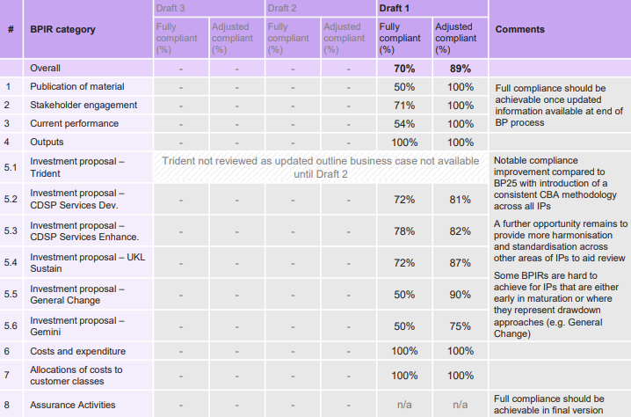
BPIR report
Xoserve scored 70% on the standard metric and 89% on the adjusted compliance score for its first draft of BP26.
This high score can be attributed to the fact that the BP has incorporated feedback received during the BP25 Assurance Review (e.g. the inclusion of a standardised Cost Benefit Analysis (CBA) methodology across Investment Proposals (IPs)
Room for improvement on IPs, including:
  Review of the updated Trident IP, which was not available for review in Draft 1
  Articulating impact on service and performance and risk of delivery across each considered option
  Quantifying the expected impact on S&O where applicable
21 October 2025

Slide 24
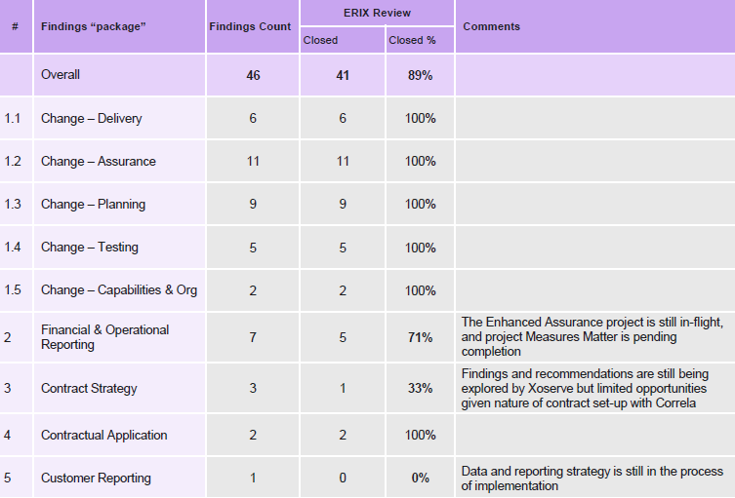
ERIX report
41 of 46 findings (89%) to have been closed, demonstrating strong commitment for Xoserve to implement the recommendations and improve its performance and efficiency
Of those items assessed as partially open:
  Financial & operational reporting: awaiting completion of ‘Enhanced Assurance’ and ‘Measures that Matter’ project
  Contract strategy: findings and recommendations still being explored by Xoserve
  Customer reporting: data and reporting strategy is being implemented and pending completion
A potential next step would be to re-benchmark performance now delivery is complete to understand the impact delivered and also understand how Xoserve now performs against peers whose performance may have also changed since the 2023 review

Slide 25
Questions?
21 October 2025

Slide 26
Close & Thank you
21 October 2025

